Slide 1
Implementation of the NISO Presentation and Identification of E-Journals (PIE-J) Recommendations
Steve Shadle
Head, Serials Cataloging, University of Washington
ER&L 2019
Notes:
PIE-J best practices are recommendations for content providers: publishers, platform providers, aggregators. But their goal is to help librarians and end users, often help librarians to help end users.

Slide 2
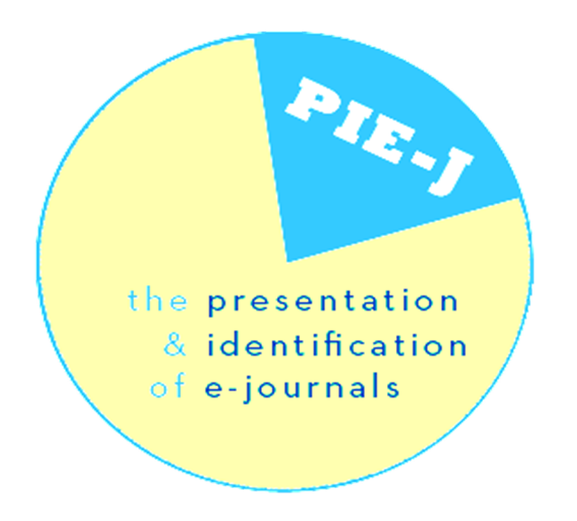
Agenda
Overview
Survey
Next Steps
Notes:
Searches were failing because all content was listed under current title—inspiring the conception of PIE-J… the birth took a little longer!

Slide 3
Overview
NISO RP-16-2013 PIE-J: The Presentation & Identification of E-Journals
Working Group of 18 librarians, publishers and vendors appointed spring 2010
Recommended Practice approved spring 2013
Standing Committee established summer 2013
Notes:
Searches were failing because all content was listed under current title—inspiring the conception of PIE-J… the birth took a little longer!

Slide 4
Key Guidelines and Considerations
Present all content under its original title
Include title histories
Include accurate and complete ISSN information
Include numbering, using the same simple scheme across formats
Include other identifying information

Slide 5
Standing Committee Charge
The PIE-J Standing Committee will:
continuously promote the PIE-J Recommended Practice
respond to specific inquiries about PIE-J
gather comments and information to assist with the 24-month review

Slide 6
Standing Committee Website
https://www.niso.org/standards-committees/pie-j
Recommended Practice
  3 pages of recommendations plus 58 pages of examples, resources, strategies, etc.
Brochures
Publisher Letter Template
24-Month Review
Conformance Survey

Slide 7
Conformance Survey
~40 publishers and vendors were contacted
27 questions asking if each of the 27 individual guidelines are followed
Responses were: Yes, No, Partial, Don’t Know, Not Applicable
Responses reflect provider’s current intended practice and may not necessarily apply to every specific journal
Some questions require in-depth knowledge and the Standing Committee often had difficulty identifying the appropriate contact

Slide 8
Survey Results
7 complete surveys submitted
Providers were mostly in compliance with PIE-J guidelines

Slide 9


2.1 Journal Title and Citation Information
Retention of the original title and citation information is essential for users trying to access the original full text
Provide full journal title prominently, clearly and consistently
Use the same journal title across all formats
Identify all content with the title under which that content was originally published
Construct any “Cite as” feature to use the citation under which the content was originally published
Ensure that all publisher outputs (alerts, syndicated data) use the journal title under which the content was originally published

Slide 10



2.2 Title Changes and Title History
Title changes should be justifiable and new ISSN should be requested. Users appreciate a journal title history showing previous and later titles.
Ensure that title change is based on change of content or scope. Refrain from cosmetic title changes
Consult the appropriate ISSN Center before changing a title
Implement a title change at the beginning of a volume or publication year
Provide a journal title history including full journal title, publication dates and ISSN

Slide 11
2.3 ISSN (International Standard Serial Number)
Accurate ISSN support e-journal linking, identification, and management. Separate ISSN are required for print and electronic versions.
Ensure each separate title has its own ISSN. Confirm ISSN with the appropriate ISSN Center
Ensure each format has its own ISSN
Display all ISSN and indicate format

Slide 12
2.4 Enumeration and Chronology Systems
Issue numbering helps users identify content and know if they have all issued content. Dates of publication are essential to indicate information currency/timeframe.
Use an enumeration system that is clear and simple when starting a new title
For chronology, use data of publication at a minimum
Keep identifying information (such as volume, issue, page numbers) consistent across all versions
Use original enumeration and chronology when posting content on the Web; do not retrospectively renumber previously existing content

Slide 13

2.5 Publication Information
To preserve journal history and editorial contributions, certain vital facts should always be included on the website and retained over time
Provide an About The Journal or Journal Information page that provides editorial, publication and sponsorship information as well as ISSN, mastheads information, errata/retraction policies, ethics guidelines, peer review status, etc. Ensure this information is retained over time
Provide a clear indication of journal title history
Retain distinctive issue-specific non-article information, such as front and back matter, journal covers, and other issue-specific metadata or information
Provide a link or contact information for librarians to submit information or question about title history or presentation

Slide 14
2.6 Access to Content
The ability to find full-text is vital for readers and to the ultimate dissemination and use of information the furthers scholarly research
Provide display and search access to current and former journal titles to ensure that all titles are available in browse lists and search features
Provide clear presentation of all volume/issue numbers and publication dates
Use a Table of Contents (and include errata) to facilitate browsing and current awareness
When possible, state where any content not available on the journal website can be found, such as when the publisher does not hold the rights to older content. When feasible, provide links to other sites
Retain content as it was published. Do not remove, rename or renumber content

Slide 15
2.7 Preservation of Content Digitized from Print
Digitization of print journals should consider the previous guidelines. Digitization project should be undertaken even when some content is unavailable. Consider using libraries for advice on and sources for digitization
Digitzie the entire original volumes or issue (including front/back covers, all internal pages and include advertisements as these are part of the historical record)
When digitizing incomplete content, clearly indicate what is missing. This will facilitate use and permit later insertion of content if missing content is located and subsequently digitized

Slide 16
Next Steps
Solicit additional surveys
Get feedback from publishers who have submitted surveys
Notes:
Searches were failing because all content was listed under current title—inspiring the conception of PIE-J… the birth took a little longer!

Slide 17
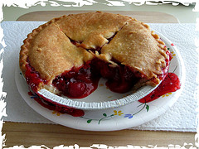
Publisher Conformance Survey
https://www.niso.org/standards-committees/pie-j

